Slide 1

Bacteria counting
Image processing
mini-project
Final presentation

Slide 2

Table of content
Implementation
Objectives
Experiments
Algorithm
Search classes
Search mecanism
Best bundle
Coarse search
Fine Search
Best bundle
Results
Data analysis
Repair, morph kernel
Time and differences
Fine search analysis
Double treshold analysis
Conclusion
Return on objectives
Lesson learned
Maxime Geminiani
University of Fribourg
Master Benefri
Mini-project final
2/32

Slide 3

1. Implementation
Description of the work done
Maxime Geminiani
University of Fribourg
Master Benefri
Mini-project final
3/32

Slide 4
1.1 Objectives
Count bacteria
Rebuild contours ?
Use methodologies seen in class
Combine
Compare
Analyse
Maxime Geminiani
University of Fribourg
Master Benefri
Mini-project final
4/32

Slide 5
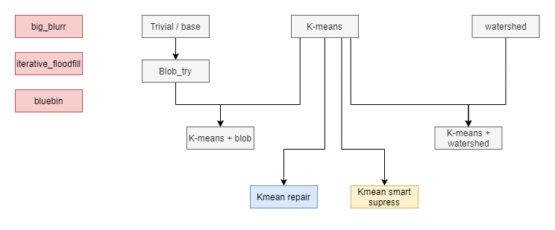
1.2 Experiments
No promising results
Big-kernel blurring (50+, Gaussian, Mean)
Iterative floodfill
Blue-focused grayscale
Promising result, aborted
Kmean smart supress
Promising result, kept
Kmean repair
Maxime Geminiani
University of Fribourg
Master Benefri
Mini-project final
5/32

Slide 6
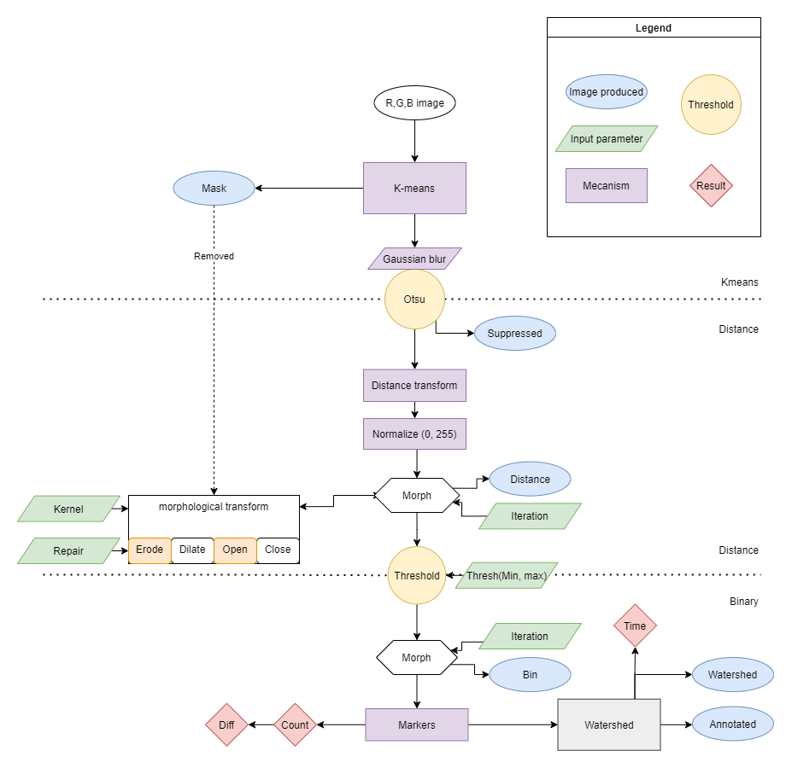
1.3 Algorithm
Methodology
Kmeans
Distance transform
Morphologies
Threshold distance
Markers
Watershed
Maxime Geminiani
University of Fribourg
Master Benefri
Mini-project final
6/32

Slide 7
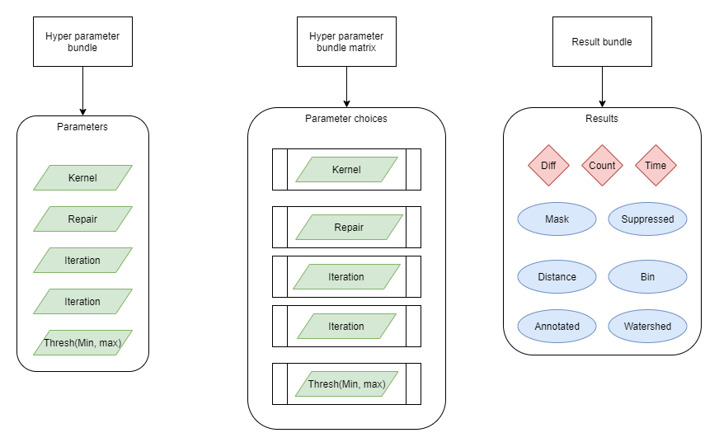
1.4 Search classes
Classes
Hyper parameter bundle
Hyp param bundle Matrix
Result bundle
Simplify processing pipeline
Maxime Geminiani
University of Fribourg
Master Benefri
Mini-project final
7/32

Slide 8
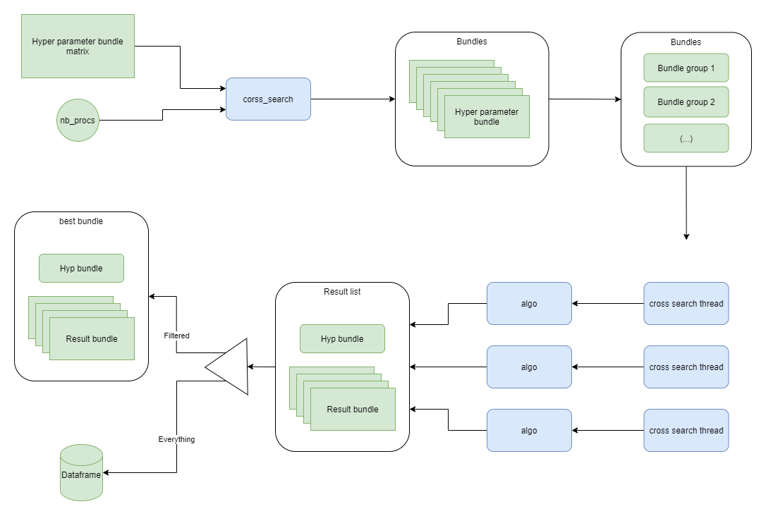
1.5 Search mecanism
Focused on multi-threading
Matrix creates bundles
Thread process bundle group
One result bundle per image
N result bundles per hyper-param
Result bundles are merged
Result bundles are stored
Best
All
Maxime Geminiani
University of Fribourg
Master Benefri
Mini-project final
8/32

Slide 9

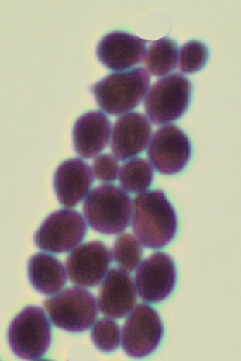
2. Best bundle
Full dataset
Best bundle
Differences
Run time
Maxime Geminiani
University of Fribourg
Master Benefri
Mini-project final
9/32

Slide 10
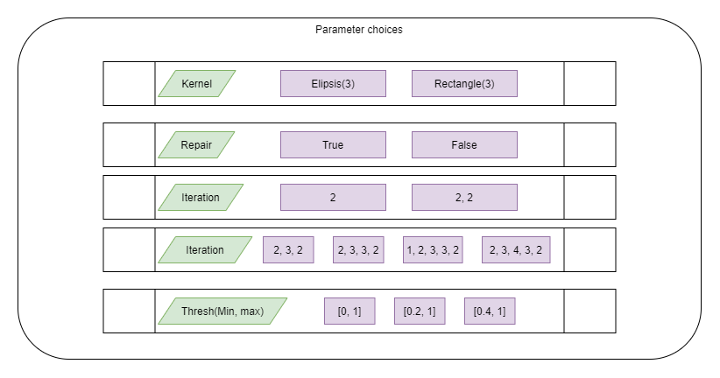
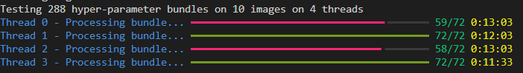
2.1 Coarse search
Maxime Geminiani
University of Fribourg
Master Benefri
Mini-project final
10/32

Slide 11
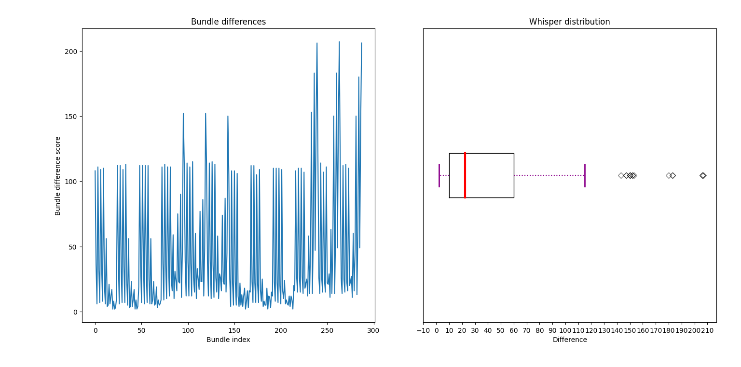
2.1 Coarse search
Good results already present
Great outliers
Median around 25
Maxime Geminiani
University of Fribourg
Master Benefri
Mini-project final
11/32

Slide 12
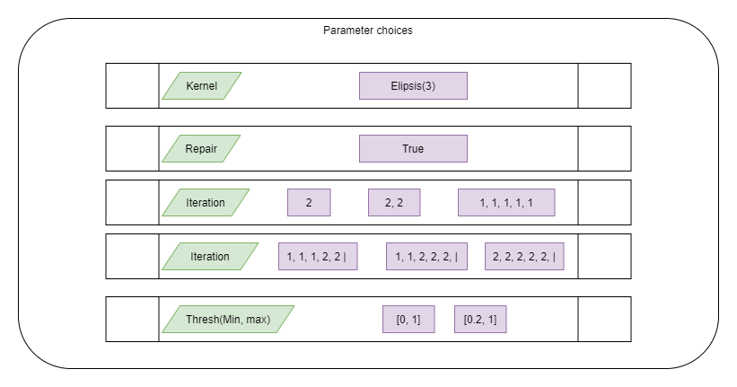
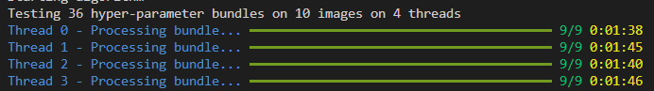
2.2 Fine search
Maxime Geminiani
University of Fribourg
Master Benefri
Mini-project final
12/32

Slide 13
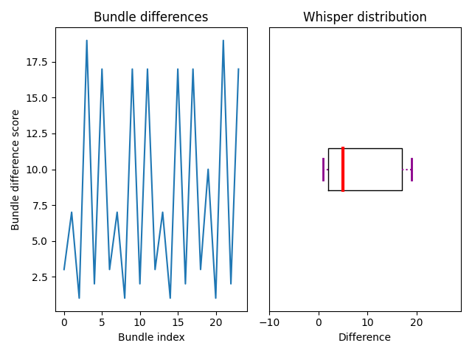
2.2 Fine search
Median, minimum way better
General distribution lower, median around 5
No outlier
Maxime Geminiani
University of Fribourg
Master Benefri
Mini-project final
13/32

Slide 14
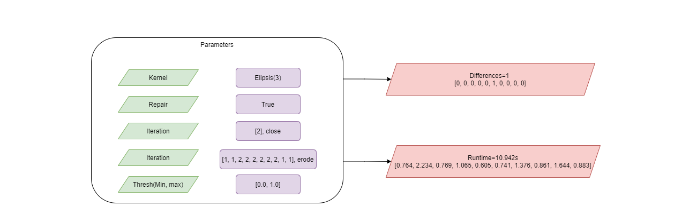
2.3 best bundle
4 best bundles equal in term of difference
Winner determined with runtime
Interesting metric could be number of operations
Maxime Geminiani
University of Fribourg
Master Benefri
Mini-project final
14/32

Slide 15
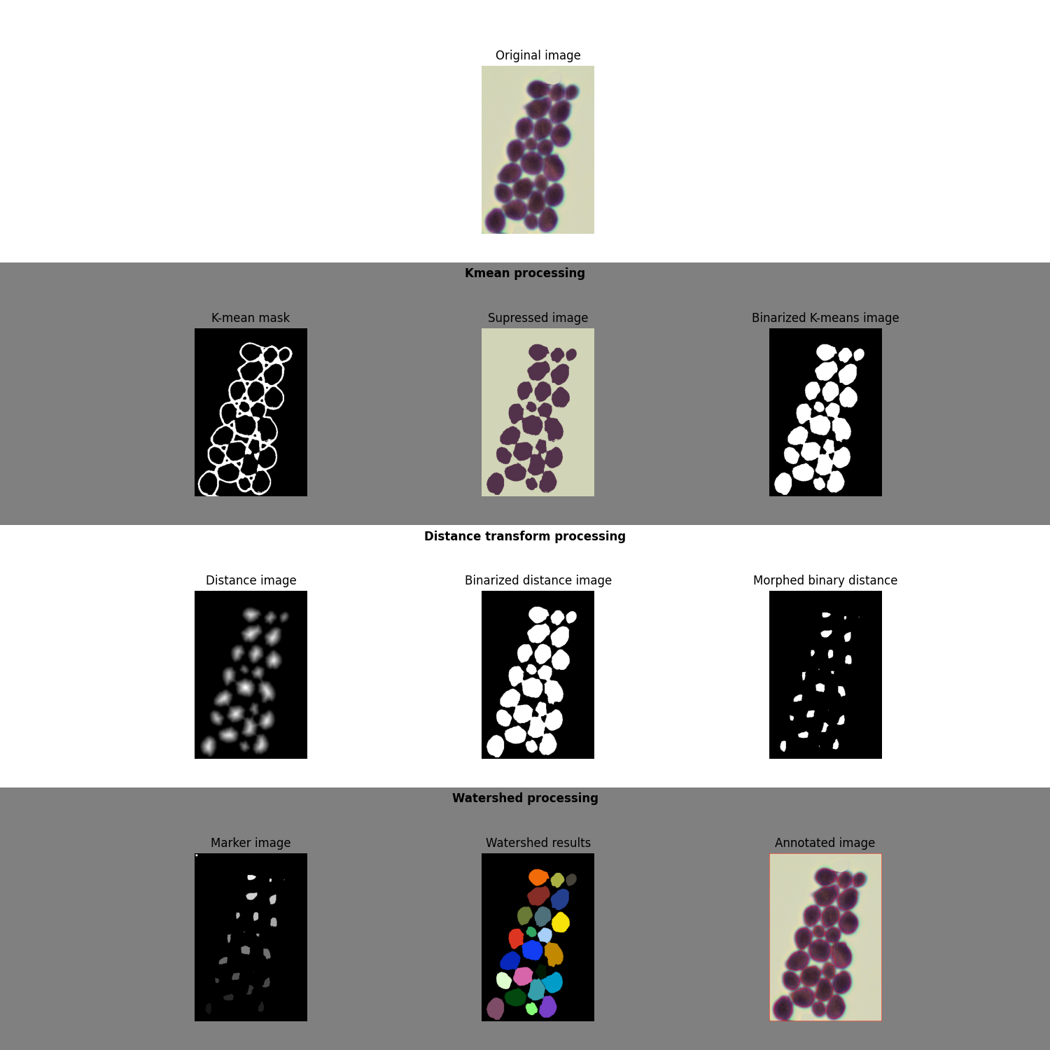
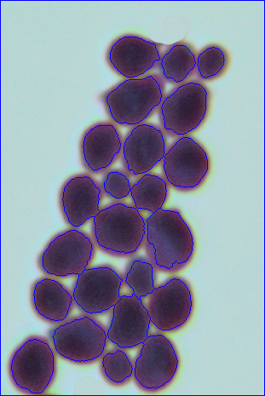
2.4 Results
Maxime Geminiani
University of Fribourg
Master Benefri
Mini-project final
15/32

Slide 16
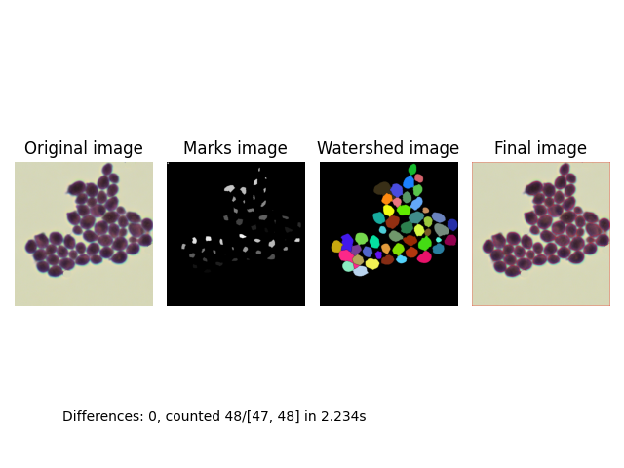
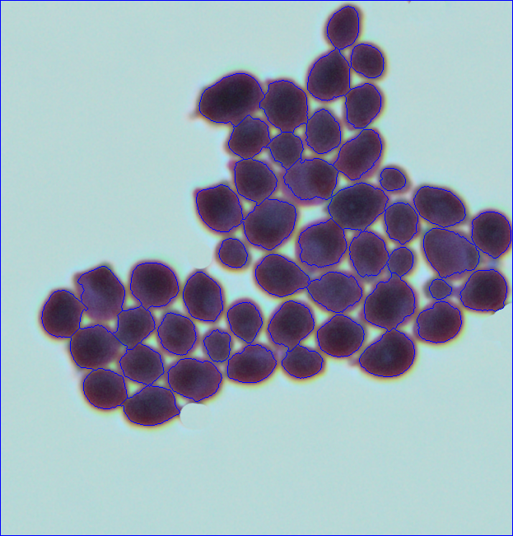
2.4 Results
Maxime Geminiani
University of Fribourg
Master Benefri
Mini-project final
16/32

Slide 17
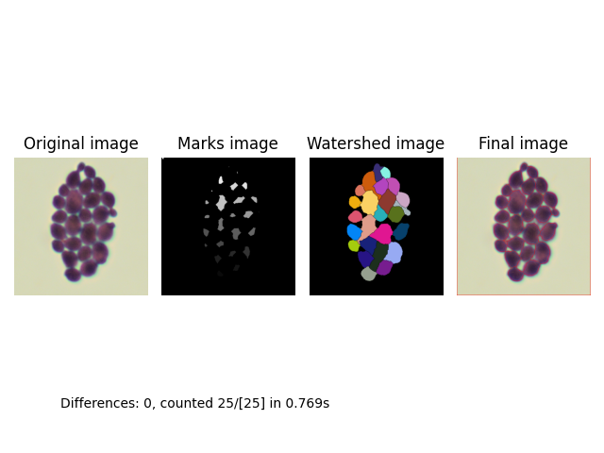
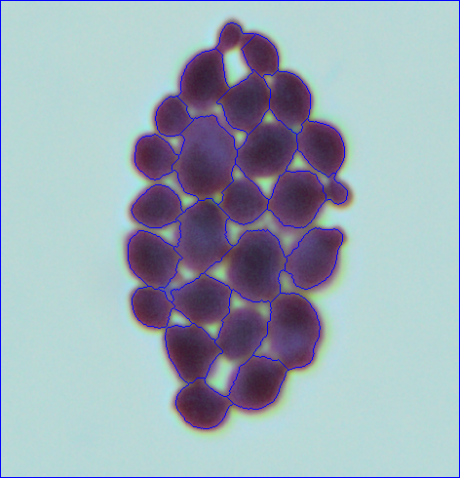
2.4 Results
Maxime Geminiani
University of Fribourg
Master Benefri
Mini-project final
17/32

Slide 18
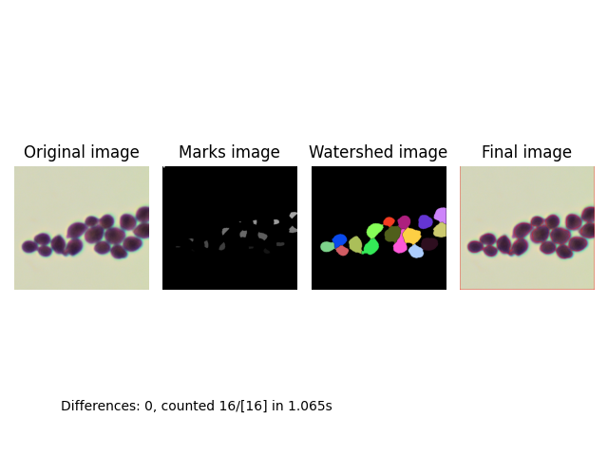
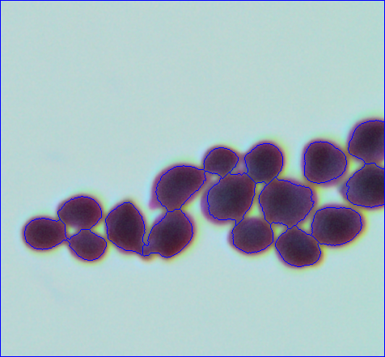
2.4 Results
Maxime Geminiani
University of Fribourg
Master Benefri
Mini-project final
18/32

Slide 19
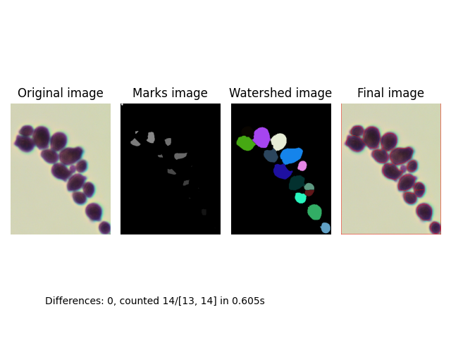
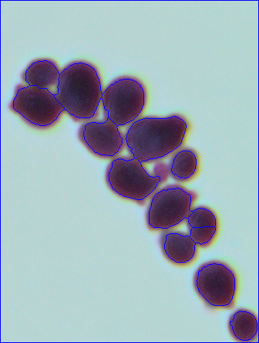
2.4 Results
Maxime Geminiani
University of Fribourg
Master Benefri
Mini-project final
19/32

Slide 20
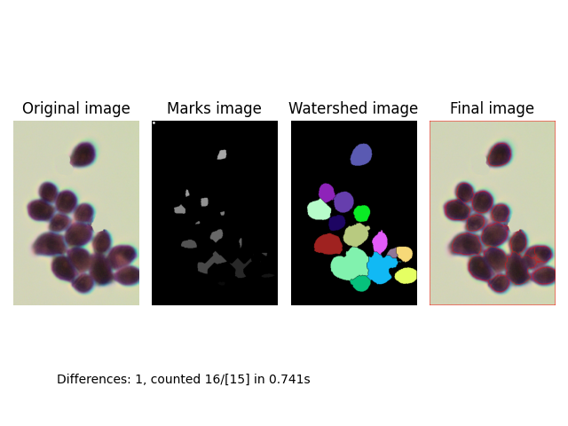
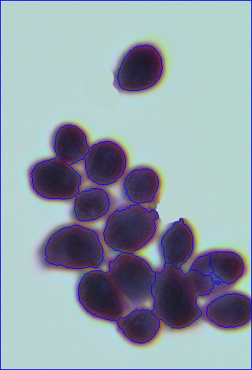
2.4 Results
Maxime Geminiani
University of Fribourg
Master Benefri
Mini-project final
20/32

Slide 21
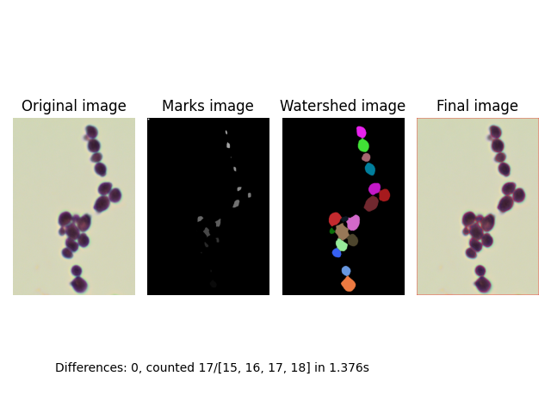
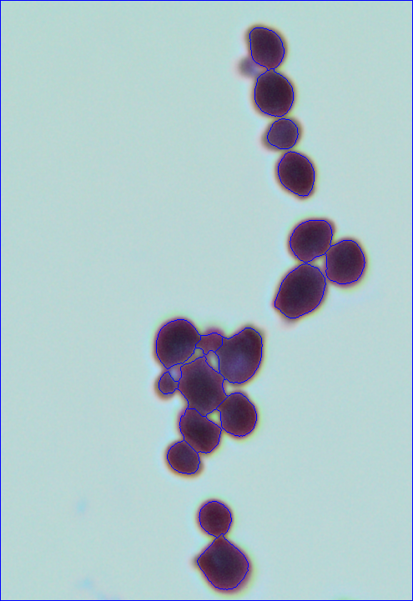
2.4 Results
Maxime Geminiani
University of Fribourg
Master Benefri
Mini-project final
21/32

Slide 22
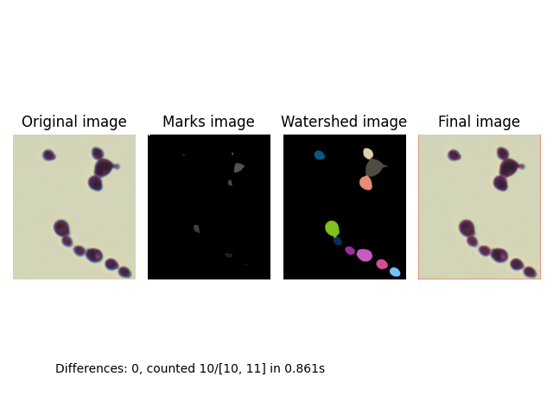
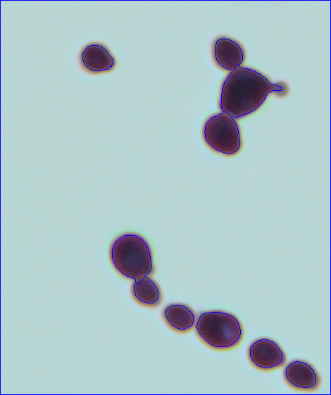
2.4 Results
Maxime Geminiani
University of Fribourg
Master Benefri
Mini-project final
22/32

Slide 23
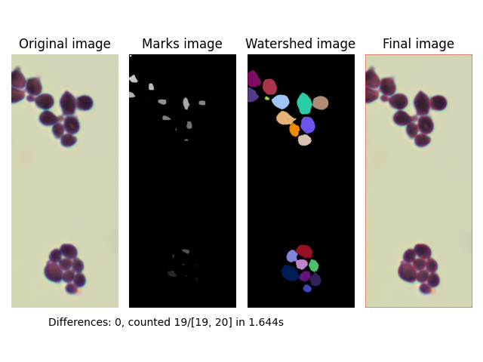
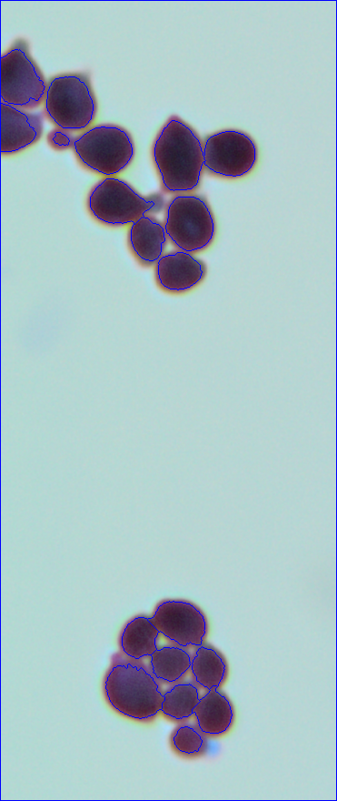
2.4 Results
Maxime Geminiani
University of Fribourg
Master Benefri
Mini-project final
23/32

Slide 24
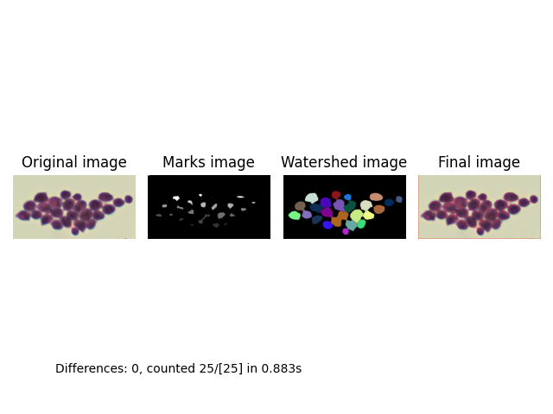
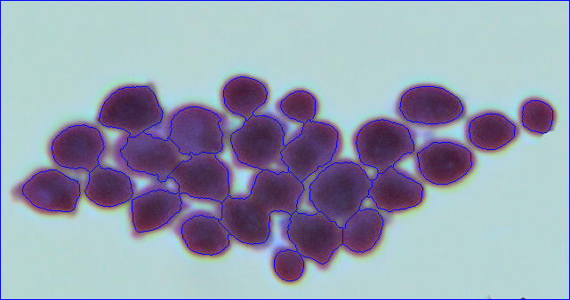
2.4 Results
Maxime Geminiani
University of Fribourg
Master Benefri
Mini-project final
24/32

Slide 25

3. Data analysis
Is our solution really good ?
What are the strength of this solution ?
Its weaknesses ?
Maxime Geminiani
University of Fribourg
Master Benefri
Mini-project final
25/32

Slide 26
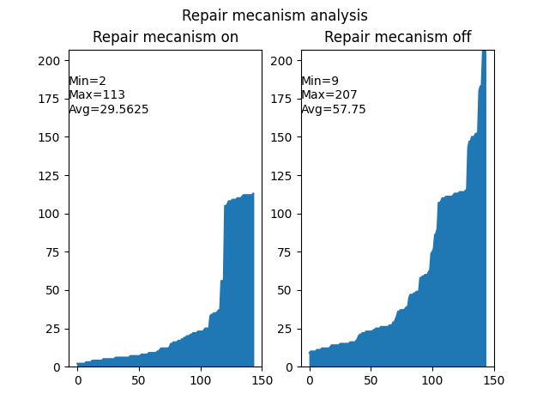
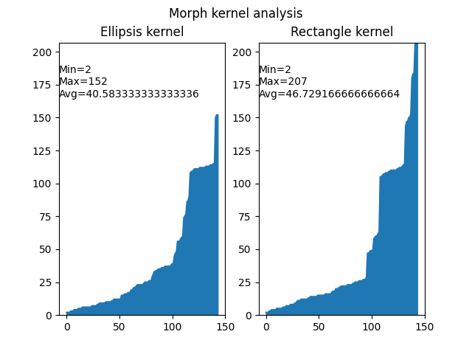
3.1 Repair, morph kernel
Maxime Geminiani
University of Fribourg
Master Benefri
Mini-project final
26/32

Slide 27
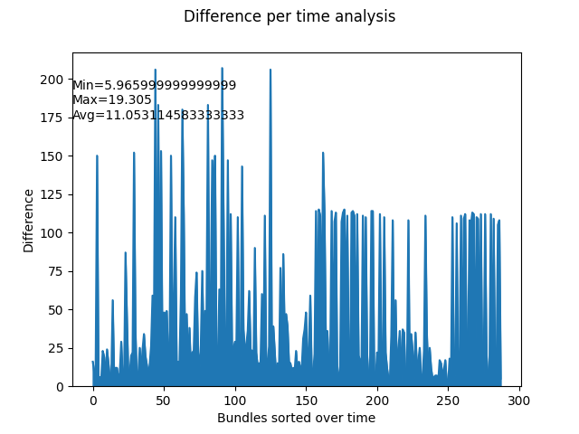
3.2 Time and differences
Maxime Geminiani
University of Fribourg
Master Benefri
Mini-project final
27/32

Slide 28
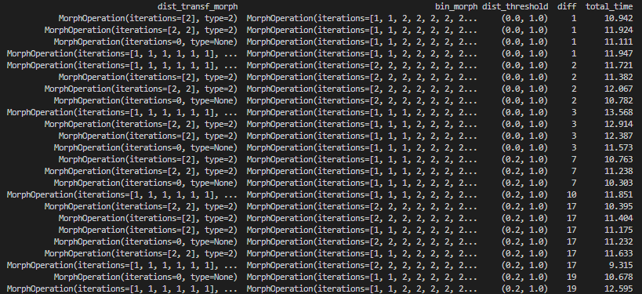
3.3 Fine search analysis
Maxime Geminiani
University of Fribourg
Master Benefri
Mini-project final
28/32

Slide 29

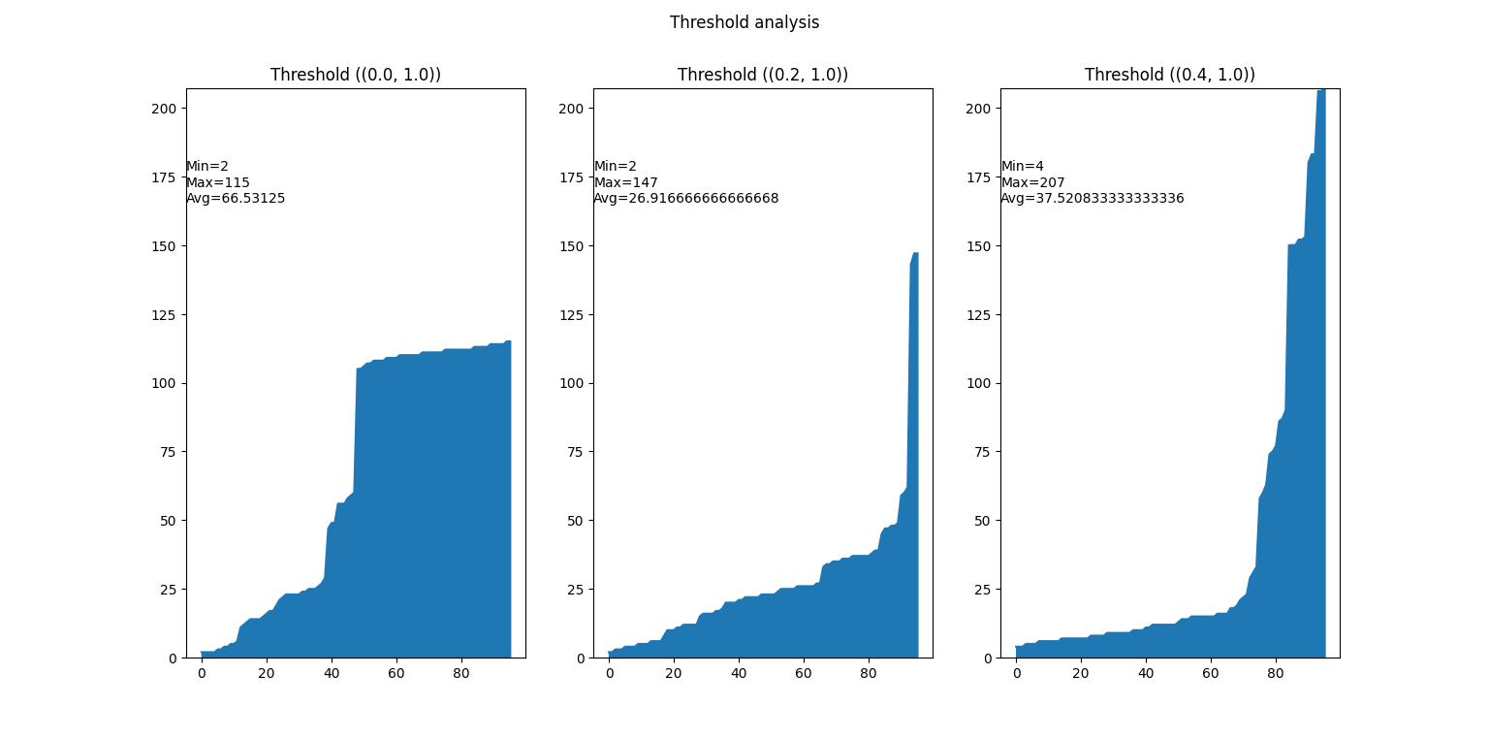
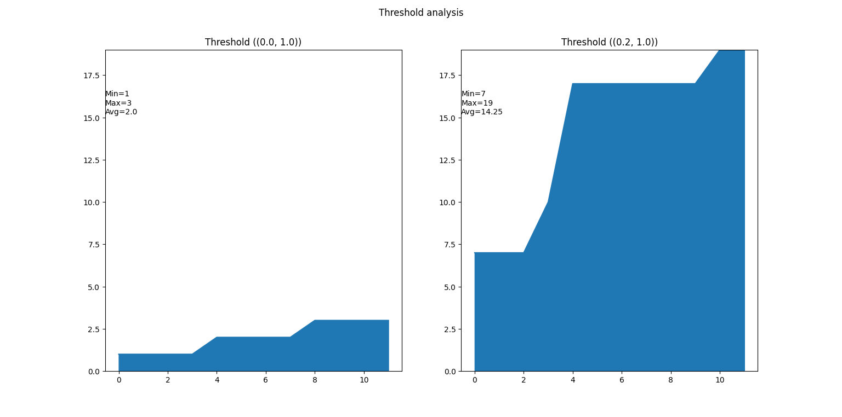
3.4 Double threshold analysis
Maxime Geminiani
University of Fribourg
Master Benefri
Mini-project final
29/32

Slide 30
4. Conclusion
Objectives
What did we learn ?
Maxime Geminiani
University of Fribourg
Master Benefri
Mini-project final
30/32

Slide 31
4.1 Return on Objectives
Counted bacteria
Rebuilt contours
Used methodologies seen in class
Combine
Compare
Analyse
Maxime Geminiani
University of Fribourg
Master Benefri
Mini-project final
31/32

Slide 32
4.2 Lesson learned
High work on fine-tuning parameters
Morphology
Adapt to different shapes and sizes
Iterative approach ?
Often, simpler solutions are better
Overcomplicating is risked
Processing time
Overfitting dataset
Maxime Geminiani
University of Fribourg
Master Benefri
Mini-project final
32/32

